Slide 1
CS 350 Operating Systems Spring 2024
Lab 4: fork, exec, wait, and dup
‹#›
Notes:
‹#›

Slide 2
Hard-coded Task 1
./task1
main()
fork()
Parent
Wait for child
Successfully waited for [child id]
Child
Print its id
exec [ls -l -a]
exit(1)

Slide 3
Task 1
Write a program which does the following:
Main process fork a child process.
Child process prints
“IN CHILD: pid=child’s_actual_pid”
Child process executes the “ls” command with “-l” and “-a” options.
This is a hard-coded execution. So using the “l” versions of exec (i.e., execl()/execlp()) may be more convenient than the “v” versions.
Parent waits for the child. Once the child is successfully reaped, parent prints
“In PARENT: successfully waited child (pid=child’s_pid)”
‹#›

Slide 4
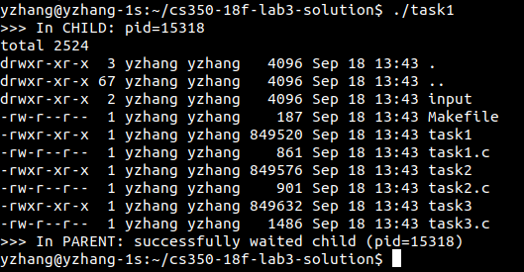
‹#›

Slide 5
user-input Task 2
./task2[input]
[input] stored in buffer
STDIN or 0
[output] stored in buffer
STDOUT or 1
main()
fork()
Parent
Wait for child
Successfully waited for [child id]
Child
Print its id
exec [input]
exit(1)

Slide 6
Task 2
Similar to task1, but the command to execute and its options are provided by user.
See some demos in the next two slides
You did an almost the same task previously. So you should know what’s the best practice here.
‹#›

Slide 7
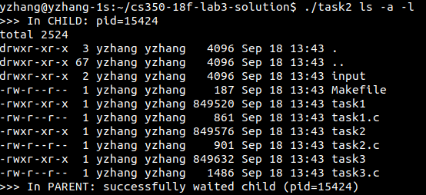
‹#›

Slide 8
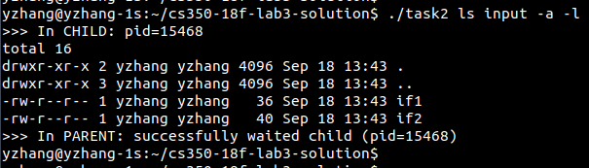
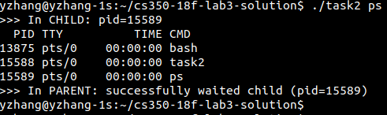
‹#›

Slide 9
dup2 Task 3
./task3 [input]
Instead of writing into STDOUT, write into a FILE named result
Instead of reading from STDIN, read from a FILE
main()
FILE name specified using a #define INPUT_FILE
fork()
Parent
Wait for child
Successfully waited for [child id]
Child
Print its id
exec [input]
use dup2 to reassociate STDIN/STDOUT to a different file
exit(1)

Slide 10
Task 3
Similar to task 2, but the difference are
The input should be taken from the file specified in the “INPUT_FILE” macro in task3.c.
Process always tries to read from file descriptor (fd) STDIN_FILENO (which is the standard input file descriptor and the value of it is 0) for input.
By default, fd STDIN_FILENO is associated with terminal input.
What you need to do here is to re-associate fd STDIN_FILENO with the fd of the actual input file.
‹#›

Slide 11
Task 3
(cont.)
The output should be written to a file named “result” which locates in the same directory as the “task3” binary.
Process always tries to write to file descriptor (fd) STDOUT_FILENO (which is the standard output file descriptor and the value of it is 1) for output.
By default, fd STDOUT_FILENO is associated with terminal output.
What you need to do here is to re-associate fd STDOUT_FILENO with the fd of the actual output file.
‹#›

Slide 12
Task 3
(cont.)
You will need to use the dup()/dup2() function for re-associating file descriptors.
Read the posted materials for how to use these two functions.
Hint: dup2() is the better option for this task.
For how to use open() to open a file, read the posted materials also.
‹#›

Slide 13
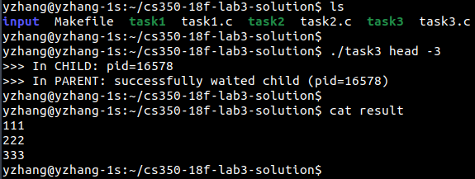
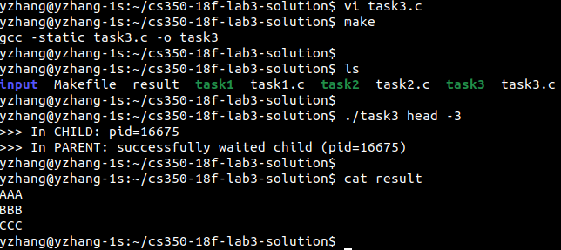
🡨 No “result”
Print the first 3 lines of
the input, which should be
now redirected to “./input/if1”
Let’s check the content
of the file “result”
Change the INPUT_FILE
macro to “./input/if2”, and
compile.
🡨 Old “result” is there.
🡨 Run it again.
“result” has been updated
based on the new input.
‹#›

